Slide 1


ECE-GY-9953: Advanced Project I Project Name: A Noble Approach To Detect Sudden Infant Death Syndrome (SIDS) And Monitor Environmental Parameters Submitted To: Professor Ivan Selesnick Submitted By: Abrar Fahim NetID: af4175 semester: spring 2023
Course Code: ECE-GY 9953
Advanced Project I
Submitted To: Professor Ivan Selesnick
Submitted by: Abrar Fahim
net ID: af4175

Slide 2
What is sids?
Sudden infant death syndrome (SIDS), sometimes known as "Cot death," is a paediatric phenomenon seen in infants less than a year old. Where unexpected death happens to a healthy-looking baby, usually during its sleep.

Slide 3
Motivation behind the project
According to the National Health Services of the United Kingdom, around 200 babies die yearly from SIDS [1]. As the number is comparatively low not much effort has been given to find cure or prevention. Therefore there is a scope research and development in this sector of paediatric disease.
1. "Sudden infant death syndrome sids." Website: https://www.nhs.uk/conditions/sudden-infant-death-syndrome-sids/

Slide 4
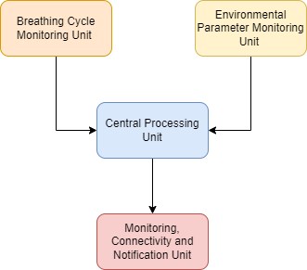
Project overview
The project is divided in to four core units
Breathing Cycle Monitoring Unit
Environmental Parameter Monitoring Unit
Central Processing Unit
Data Visualization, Connectivity, and Notification Unit

Slide 5
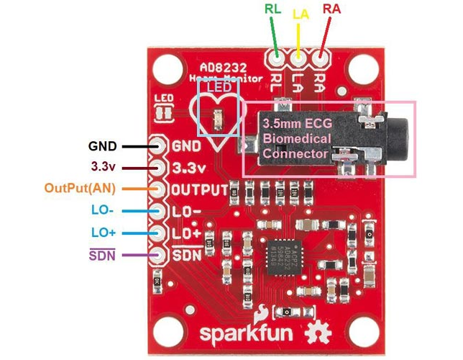
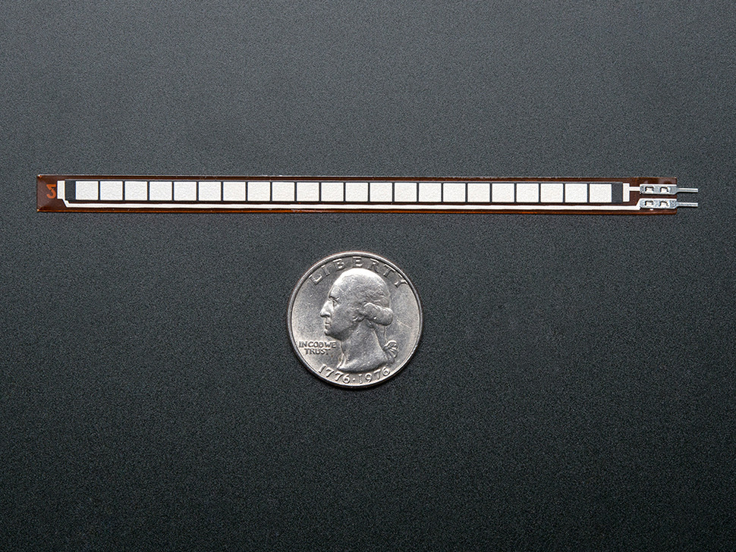
Breathing Cycle monitoring Unit
This unit contain the two most crucial components of this system which detects apnea:
AD8232 Heart Rate Monitoring Sensor
Long Flex Sensor
Fig : AD8232 Module _{(Source)}
Fig : Long Flex Sensor _{(source)}

Slide 6
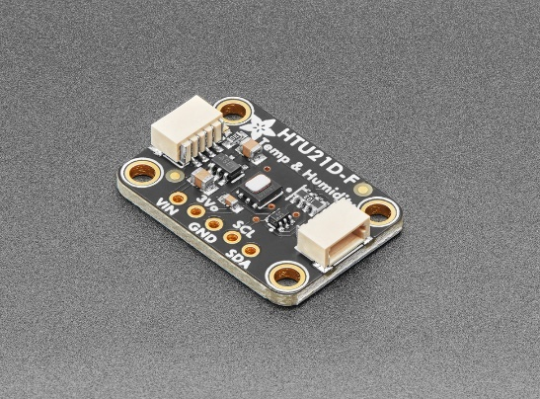
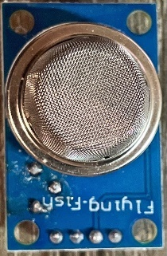
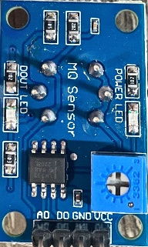
Environmental Parameter Monitoring Unit
This unit contains two sensors:
HTU21D-F Temperature and Humidity Sensor
MQ-2 Gas Sensor
Fig : HTU21D-F Temperature and Humidity Sensor_{(Source)}
Fig : MQ-2 Sensor Front & Back Side

Slide 7
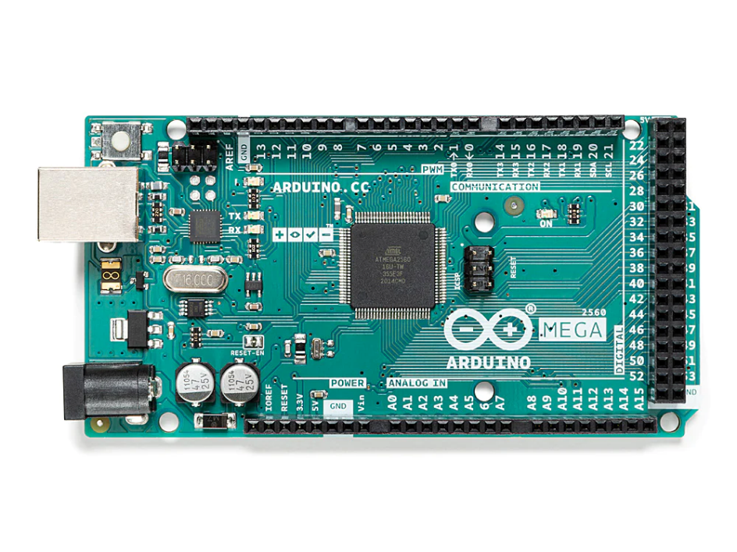
Central Processing Unit
For processing the output data from the sensor we have utilize Arduino Mega 2560 MCU.

Slide 8
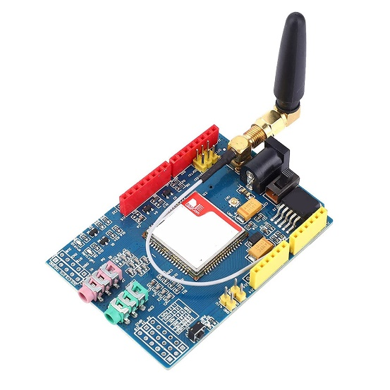
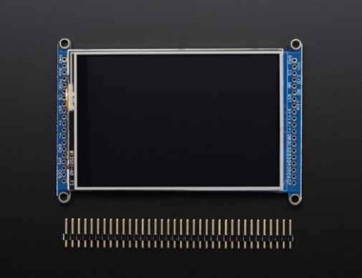
Monitoring Connectivity& Notification unit
For visualizing the output data from the sensor we have used Adafruit 3.5’’ (320x480) color TFT LCD.
For text based notification and connectivity we have used SIM900 GSM/GPRS Module.
For sound based alert we have used a simple buzzer.
Fig 4.6a: SIM900A GSM/GPRS Module (Source)
Fig: Adafruit 3.5" (320x480) TFT LCD Display Breakout Board.

Slide 9
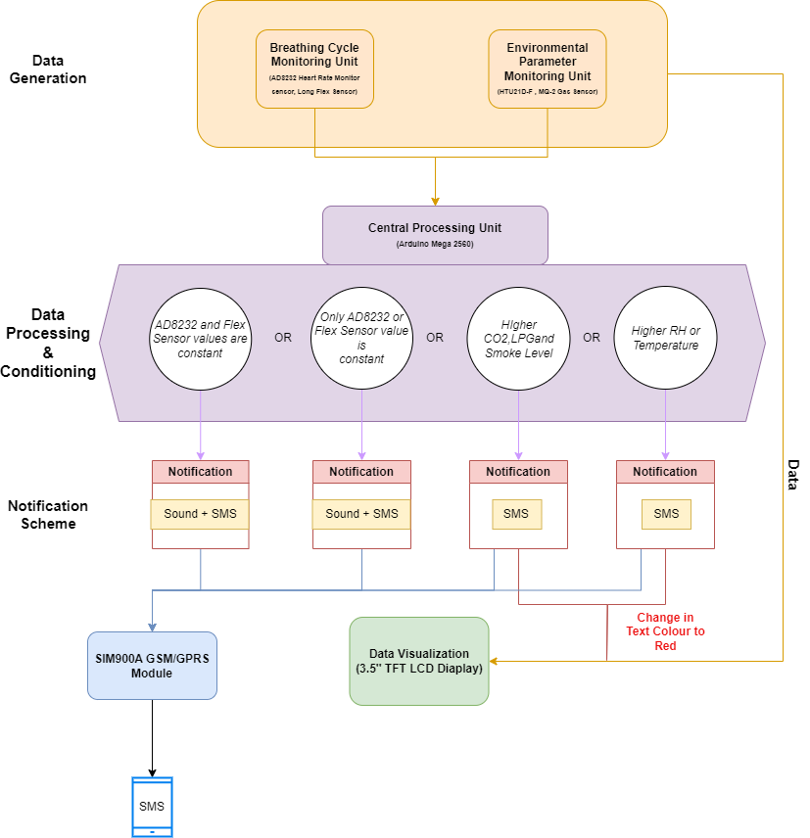
Working principle

Slide 10
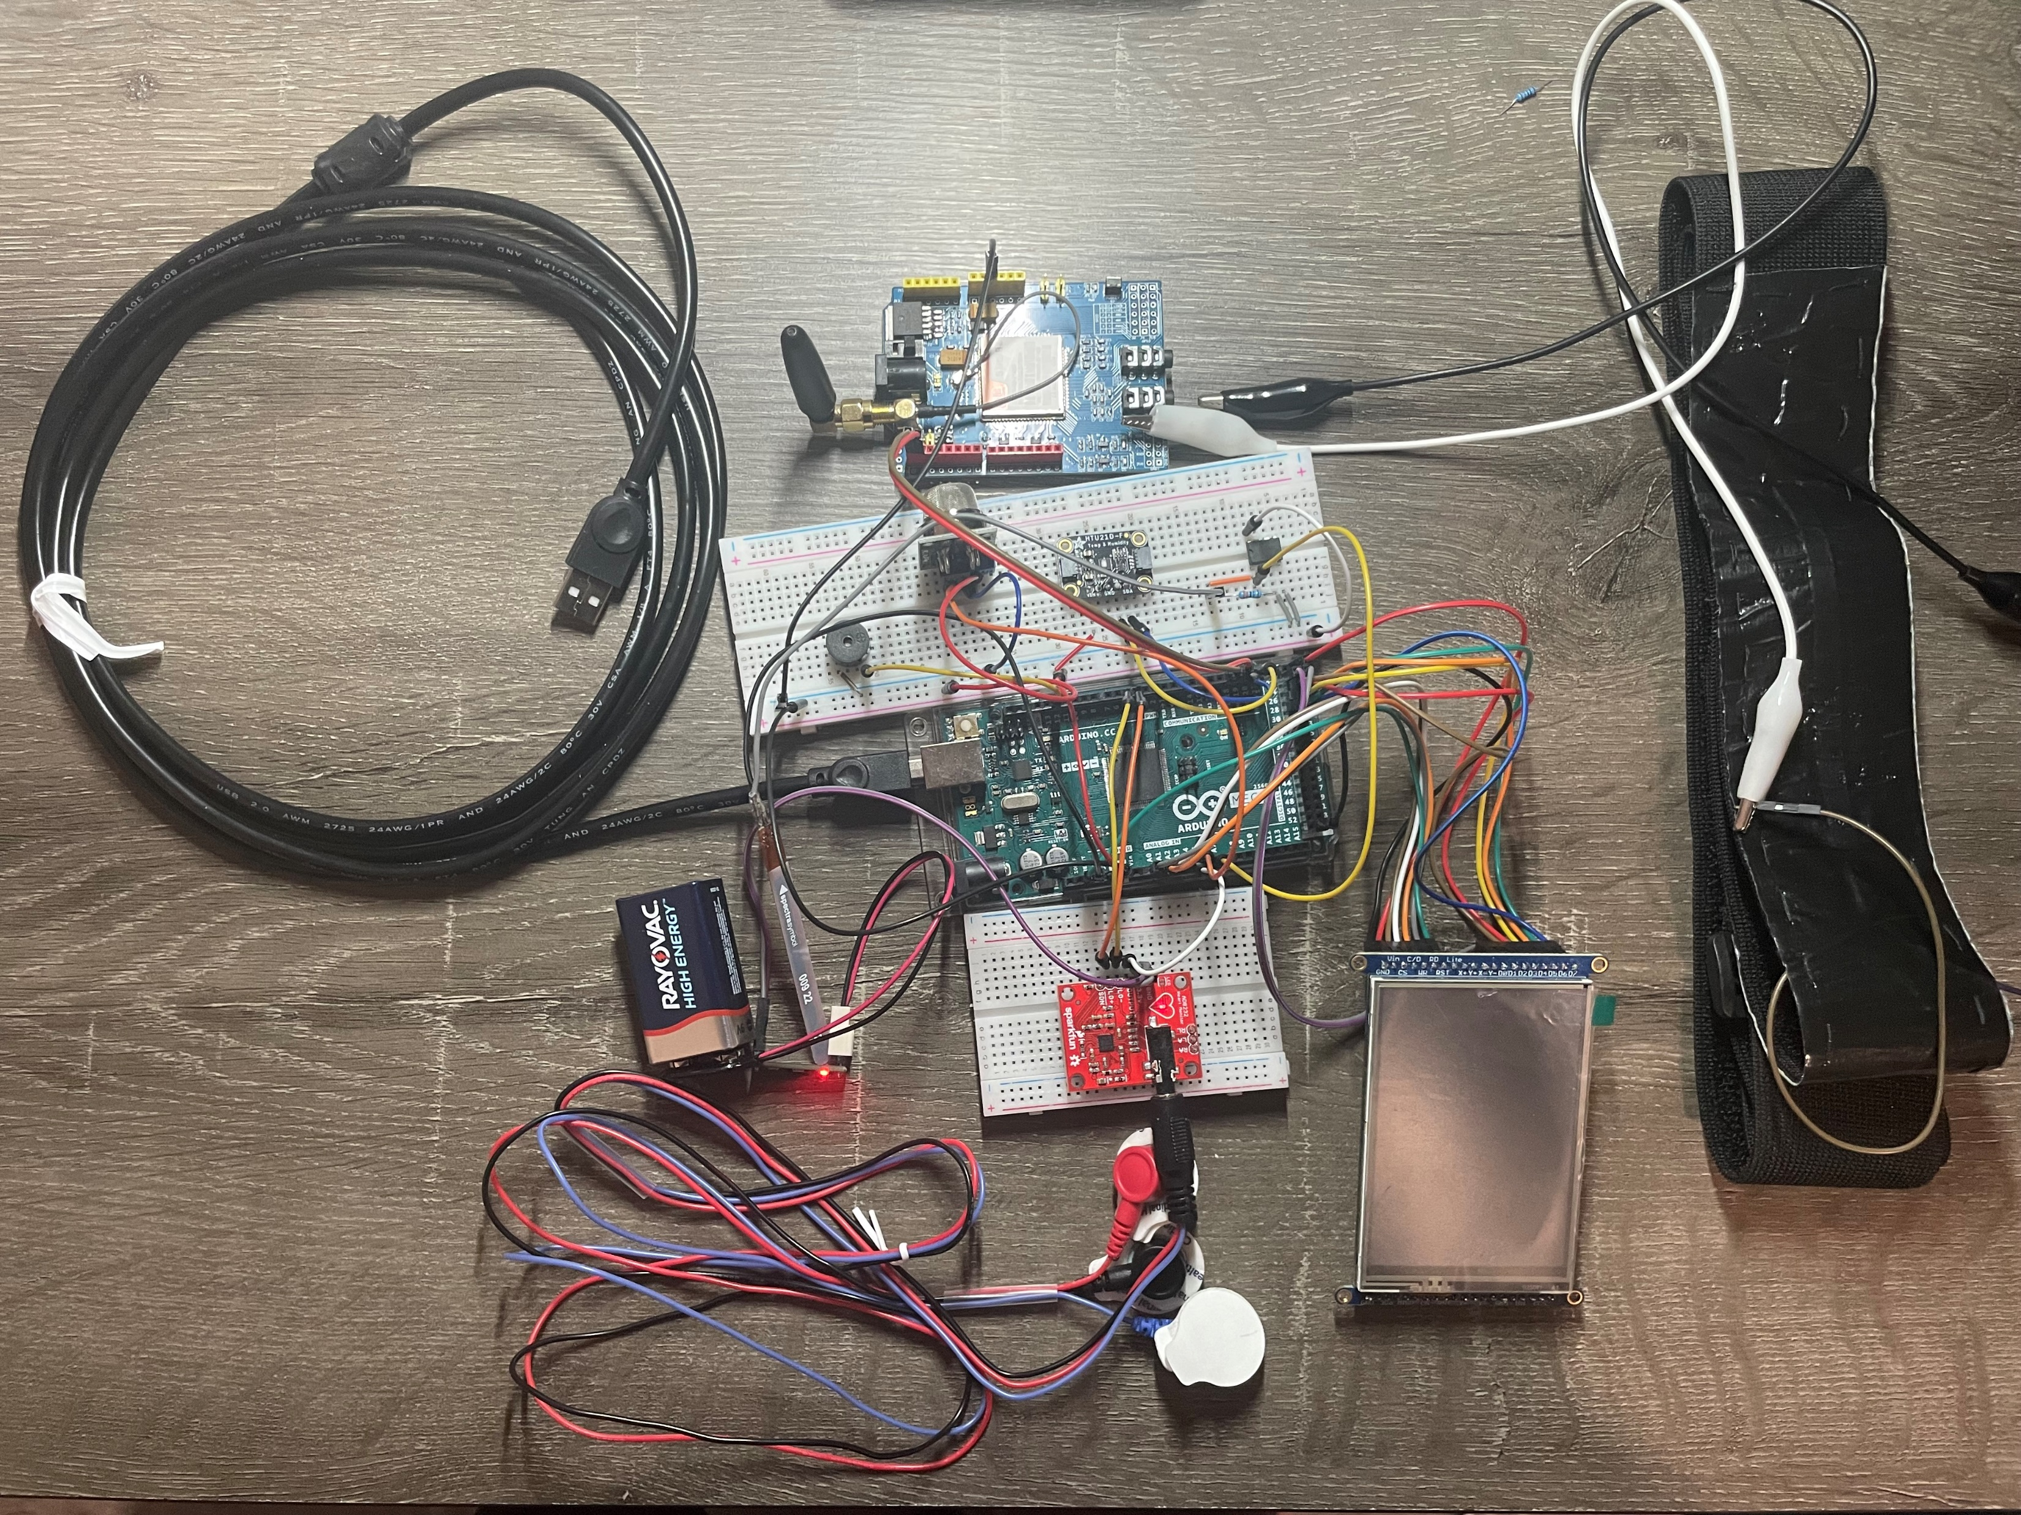
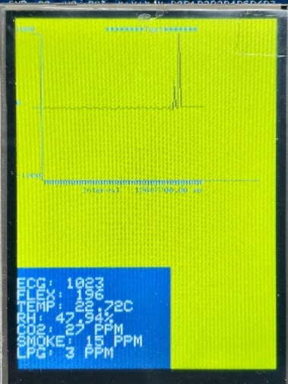
Actual circuitry and display

Slide 11
Short System Demo
https://drive.google.com/file/d/16V5U_YjRychQGawAvGgPgZe-52xghBGj/view?usp=sharing

Slide 12
Thank you

